Slide 1
To Establish Baseline for Threat Detection
Name: Goyal Taruchit Tarun Chitra
BITS ID: 2022DC04496
Course: WILP M Tech Data Science and Engineering
Supervisor: Ms. Prathibha Rao
Institute: Birla Institute of Technology and Science Pilani
Month and year: February 2025

Slide 2
Goals of the project
To build binary class and multi-class classifiers to detect and differentiate between malicious and benign events in a network.
To use heuristic algorithms for feature selection to optimally train the classifiers.
To build benchmark on quality of results that can be achieved without usage of advance methods like Deep learning and Graph Neural Networks
Robust evaluation of models and understand the reasons for the outcomes observed

Slide 3
Summary of literature survey
Most researchers rely on advance techniques to train models.
Some of the heuristic algorithms were used for optimal feature selection: -
Ant Colony optimization
Particle Swarm optimization
Artificial Bee Colony optimization
Accuracy was a commonly used metric used to evaluate results of feature selection.
Evaluation of models were carried out on 3-4 metrics: -
Accuracy
Precision
Recall
F1-Score

Slide 4
Gaps observed in literature survey
Handling imbalanced datasets is an essential problem while dealing with real-world use cases, only using accuracy does not help to address the same.
Usage of few metrics for evaluation does not help to get overall quality of the classifiers.
Size of datasets used are very small: -
Number of records range between 50 to 3000.
Number of independent features range between 4 to 25.
Usage of Machine Learning algorithms is compute intensive.
Number of iterations range between 100 to 1000 thus, compute intensive approach.
Lack of emphasis to fetch smaller subset of optimal features.

Slide 5
Cybersecurity use cases in the industry
Some of the industry use cases for cybersecurity: -
Classification of email as spam and not-spam, phishing and not-phishing.
Summarization of Indicators of Compromise (IOCs) for intrusion detection system.
Real time monitoring and alerting when events generate spikes greater than threshold are observed.
UEBA for anomaly detection.

Slide 6
Analysis and selection of datasets
Seven opensource cybersecurity datasets were fetched and analysed based on following parameters: -
Number of records
Number of features
Number of duplicates
Number of null records
Based on above parameters, CIC dataset was selected.
Properties of the dataset: -
Naturally captured, overcomes drawbacks of synthetic datasets.
No null records
Very large volume of data: 9167581 records and 57 independent features

Slide 7
Data pre-processing
Removal of duplicates.
Handling outliers using two methods: -
Winsorization
Imputation with median
Handling negative values by imputing them with median
Removing features with only one unique value.

Slide 8
Exploratory Data Analysis

Slide 9
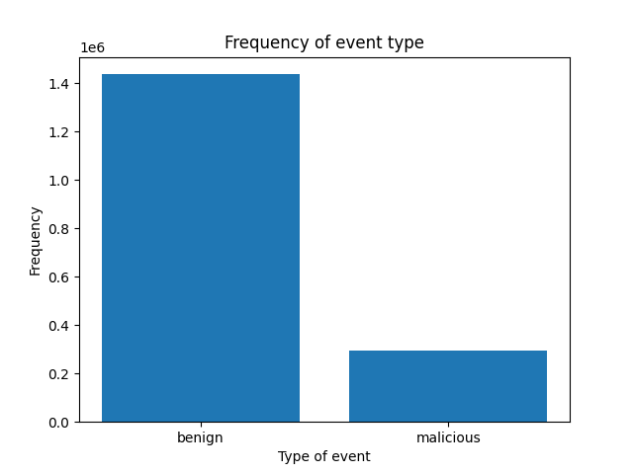
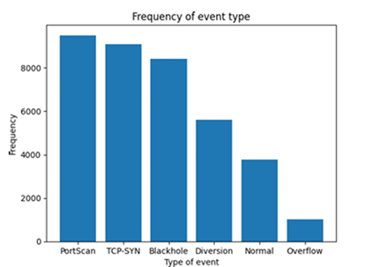
Class imbalance in the dataset
Visualization of class imbalance in the dataset using Bar chart.
Figure 1: Visualizing class imbalance for binary class classification Figure 2: Visualizing class imbalance for multi class classification

Slide 10
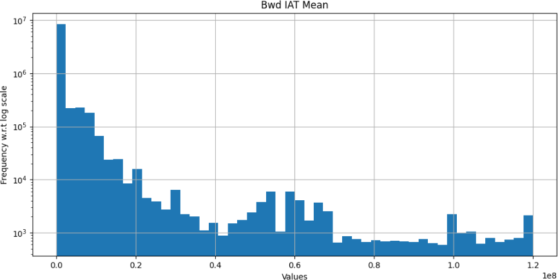
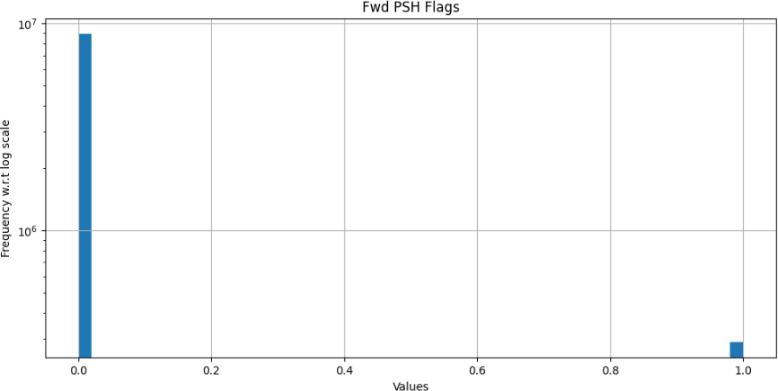
Visualizing and interpreting distribution of each feature
Figure 3: Histogram to visualization distribution of Bwd IAT Mean
Figure 4: Histogram to visualization distribution of Fwd PSH Flags

Slide 11
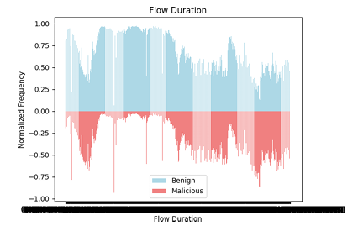
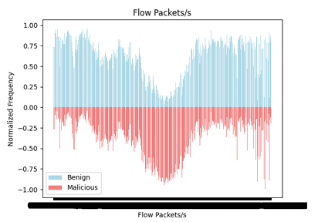
Pyramid chart for binary classification of each feature
Figure 5: Pyramid chart for Flow Duration w.r.t isMalicious
Figure 6: Pyramid chart for Flow Packets/s w.r.t isMalicious

Slide 12
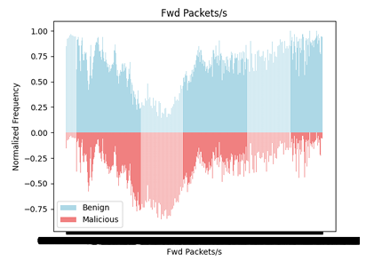
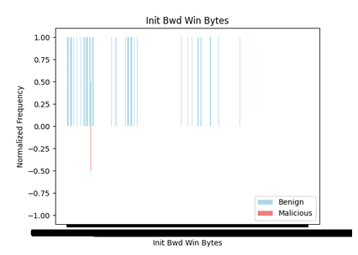
Pyramid chart for binary classification of each feature
Figure 7: Pyramid chart for Fwd Packets/s w.r.t isMalicious
Figure 8: Pyramid chart for Init Bwd Win Bytes w.r.t isMalicious

Slide 13
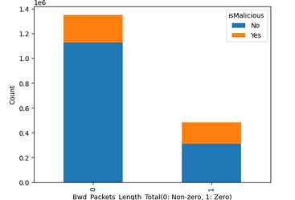
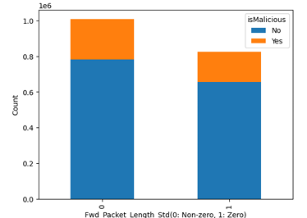
Visualization based on descriptive statistics
Figure 9: Stacked bar chart for comparison of isMalicious for zero and non-zero values of Bwd Packets Length Total
Figure 10: Stacked bar chart for comparison of isMalicious for zero and non-zero values of Fwd Packet Length Std

Slide 14
Flowchart to build test dataset

Slide 15
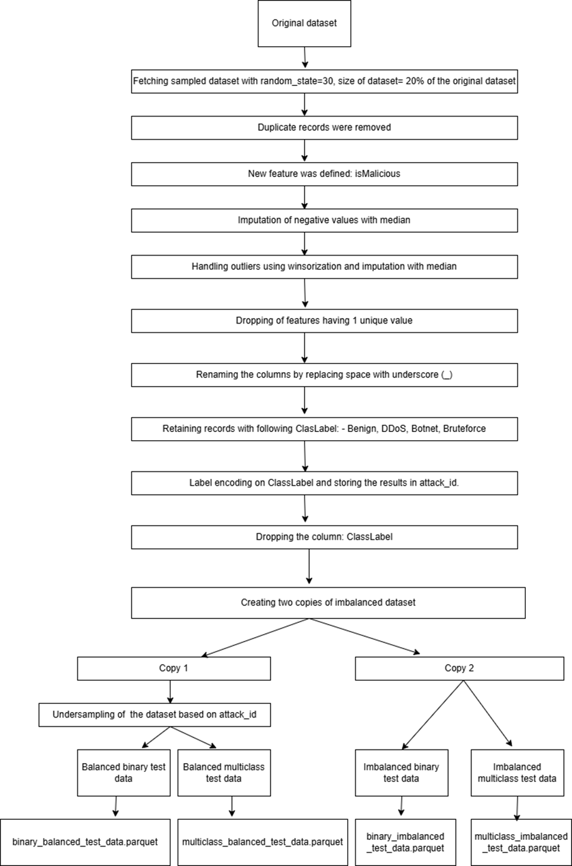

Slide 16
Heuristic algorithms
There are over 40 nature inspired heuristic algorithms.
3 Es of heuristic algorithms: -
Exploration
Exploitation
Evolution
Following two algorithms were studied and implemented for feature selection: -
Artificial Bee Colony optimization
Flower Pollination Algorithm

Slide 17
Artificial Bee Colony optimization
3 major phases: -
Employed bee phase
Onlooker bee phase
Scout bee phase
Uses a different objective function and fitness function, unlike other heuristic algorithms.
Perform Greedy search for comparing current solution with partner solution and select the best among them
It searches for partner solution in neighbourhood of current solution.

Slide 18
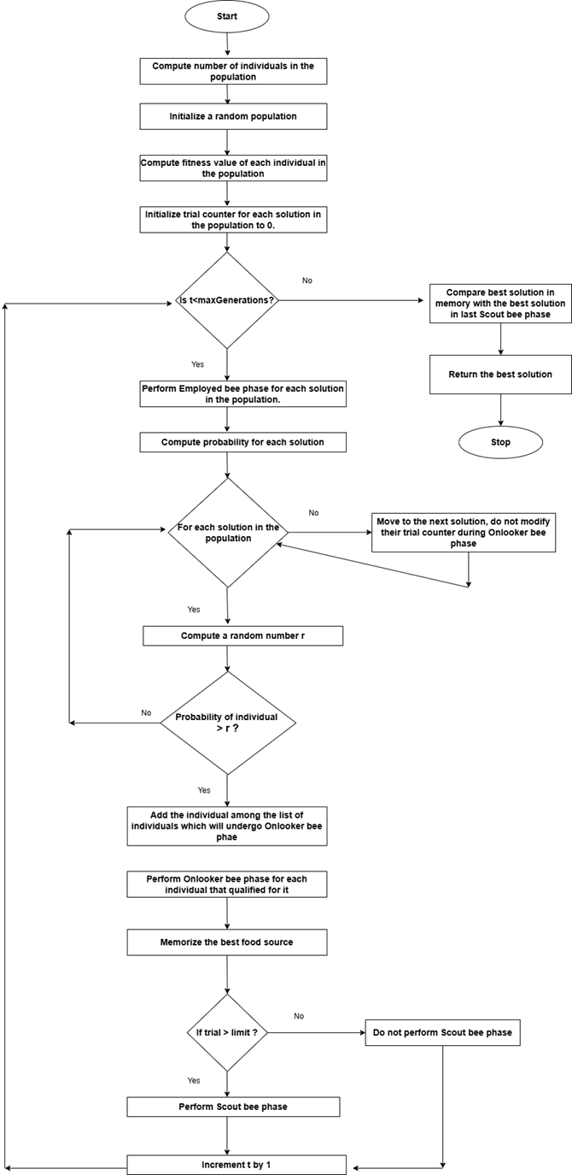

Slide 19
Flower Pollination Algorithm
2 major phases: -
Global pollination
Local pollination
In Global pollination, it searches for new solutions using Levy distribution.
In Local pollination, it searches for new solutions using Normal distribution.
Switch probability helps to determine which phase gets executed in each iteration.

Slide 20
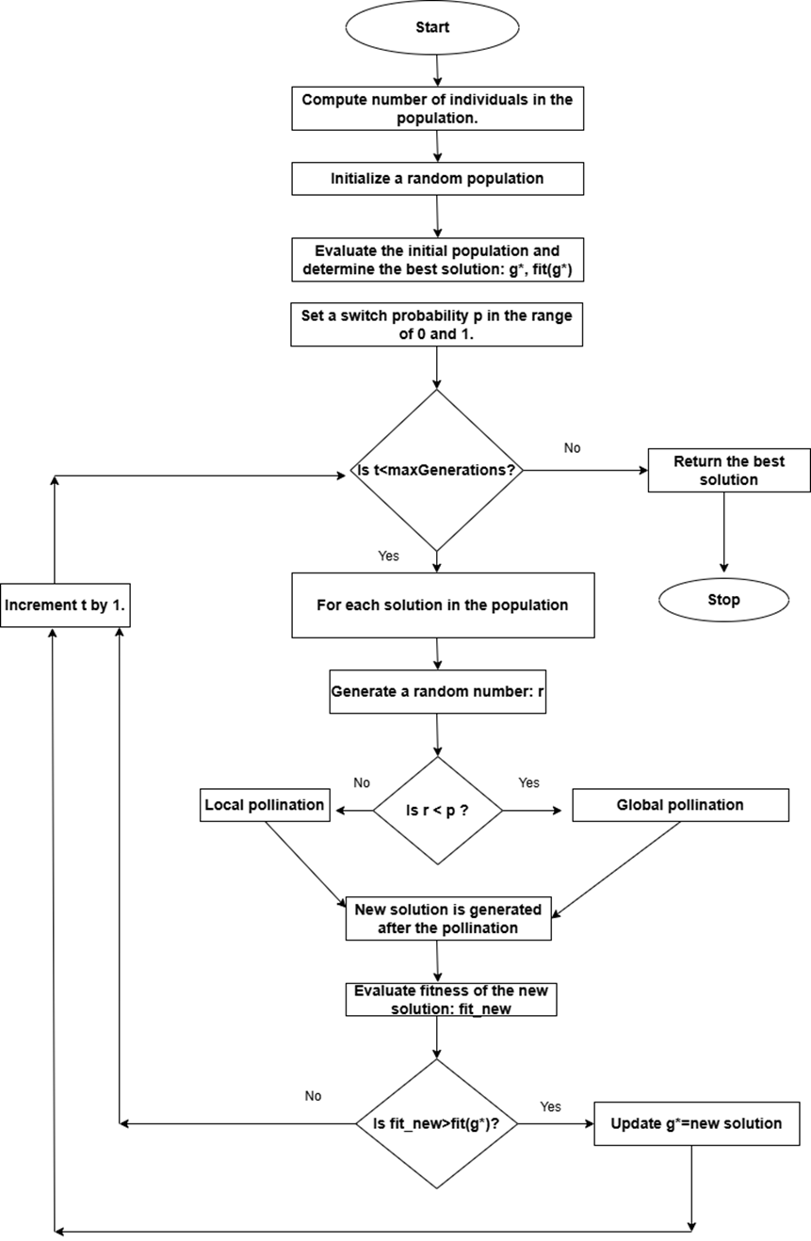

Slide 21
Machine Learning algorithm
Following are some of the ML algorithms used for training classifier models: -
Logistic Regression
Support Vector Machine
Decision Trees
Random Forest
Naïve Bayes
K Nearest Neighbour
K Nearest Neighbour (KNN) was used in the project.
Reason for selecting KNN: -
Lazy learner: Computationally lesser intensive during the training phase.
Used for both binary and multi-class classification
Commonly used in fraud detection and medical diagnosis.

Slide 22
Evaluation metrics
Following evaluation metrics were used for robust evaluation of classifiers: -
Confusion matrix
Accuracy
Precision
Recall
F1-Score
ROC curve
AUC score
Balanced accuracy
Matthews Correlation Coefficient
Negative Predictive Value
False Discovery Rate
Cohen Kappa metric
Precision – Recall curve

Slide 23
Scaling of independent features
Two independent scaling approaches were used: -
Standard Scaler
Robust Scaler

Slide 24
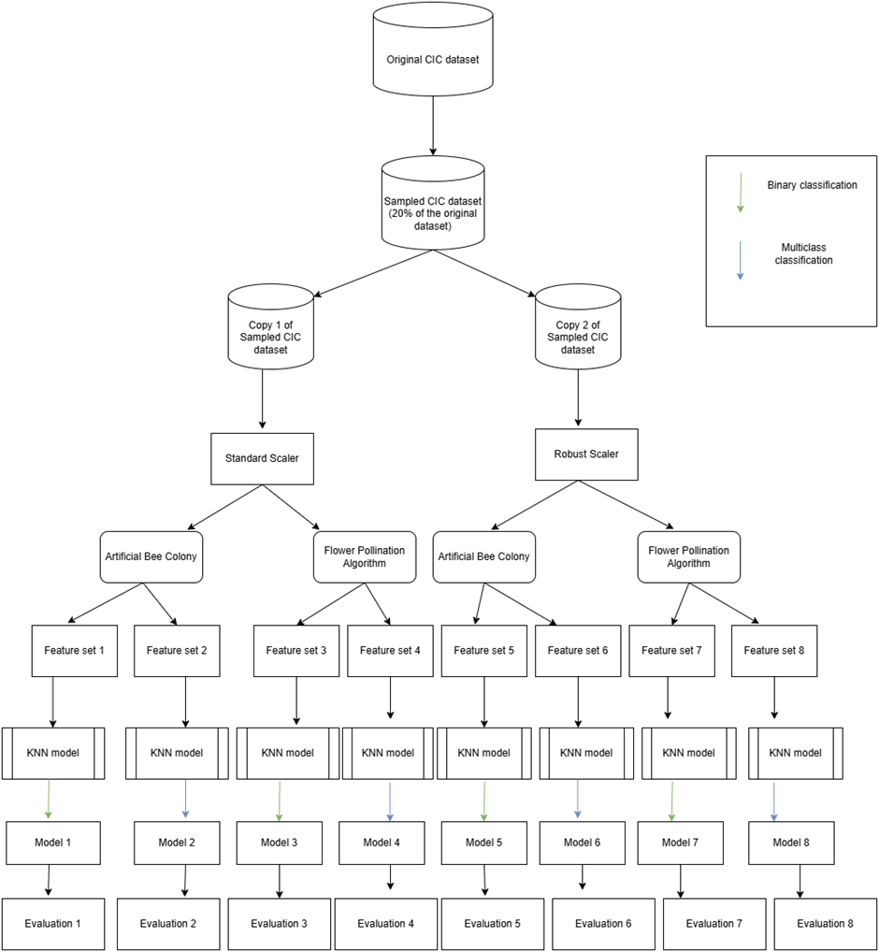

Slide 25
Defining objective function for feature selection
Feature selection has two conflicting objectives: -
Having high performance by maximizing the number of correct classifications.
Having smaller subset of optimal features to reduce model complexity.
Moreover, in cybersecurity use case, correct classification of malicious events is more important than correct classification of benign events.
Thus, the objective function was defined using “Recall” and “Penalty” and taking their difference.
Recall = Focuses on maximizing correct classification of malicious events (which are lesser in number due to imbalance nature of data) and reducing incorrect classification of malicious events as benign.
Penalty = It takes product of two ratios: -
Number of features in the current subset/Total number of features
Current iteration/Total number of iterations
And multiples the product by 2.

Slide 26
Example to illustrate computation of objective value
Total number of independent features after pre-processing = 45
Current subset of features = 10
For generation 1: - penalty = (10/45) * (1/5) * 2 = 0.088
For generation 2: - penalty = (10/45) * (2/5) * 2 = 0.178
For generation 3: - penalty = (10/45) * (3/5) * 2 = 0.267
For generation 4: - penalty = (10/45) * (4/5) * 2 = 0.356
For generation 5: - penalty = (10/45) * (5/5) * 2 = 0.444
Thus, for same subset of features the penalty value gets increased as we progressed further in generation.

Slide 27
Illustration to explain impact of penalty on overall computation
Let us consider the below scenario observed at the end of 5th generation: -
1. Subset 1: 35 features, Recall = 0.98
Penalty = (35/45) * (5/5) * 2 = 1.56
Updated value of objective function = 0.98 – 1.56 = -0.59
2. Subset 2: 15 features, Recall = 0.90
Penalty = (15/45) * (5/5) * 2 = 0.67
Updated value of objective function = 0.90 – 0.67 = 0.23

Slide 28
Configurations during feature selection and model training
KNN: - Default value of k=5 was chosen.
Number of generations (iterations) = 5
Objective function = Recall – Penalty
Number of subset of features evaluated in each iteration of feature selection = 22

Slide 29
Evaluation of classifiers

Slide 30
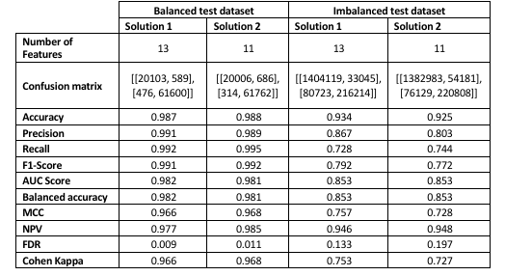
Evaluation results for Binary classification

Slide 31
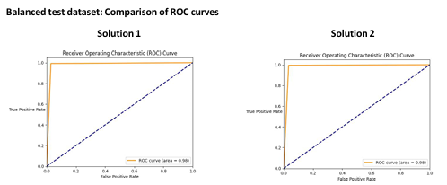
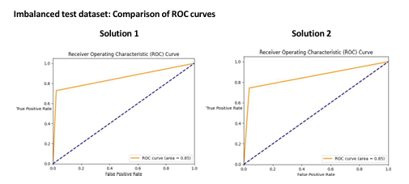
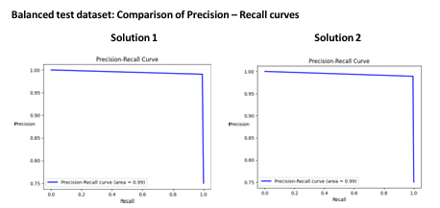
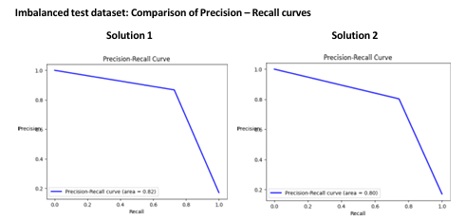
Evaluation results for Binary classification

Slide 32
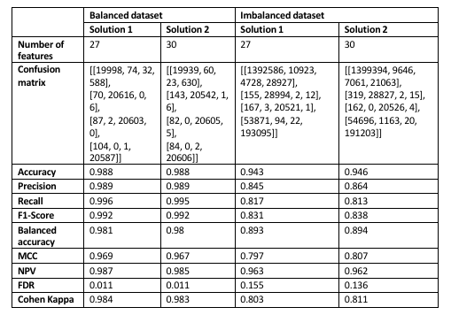
Evaluation results for Multi-class classification

Slide 33
Summary of evaluation
Flower Pollination Algorithm > Artificial Bee Colony optimization
Standard Scaler > Robust Scaler
Balanced test datasets > Imbalanced test datasets
Overlapping results were observed when compared with models in literature survey.

Slide 34
Conclusions
Heuristic algorithms can help to achieve high performance classifiers by fetching optimal subset of features.
Choice of scaling approach plays an important role in outcome of feature selection and performance of models.
Experimentation and understanding of different parameters is important to understand obtain global optimal results.
Evaluation of models with diverse metrics and comparing them is essential for robust evaluation of their performance.
Trade-off between number of features used to train the model and performance of the model is essential to address for achieving desired results.
Experiments and research on imbalanced, large and real-time datasets is essential to build models which can help in real-world cyber security applications.

